Slide 1
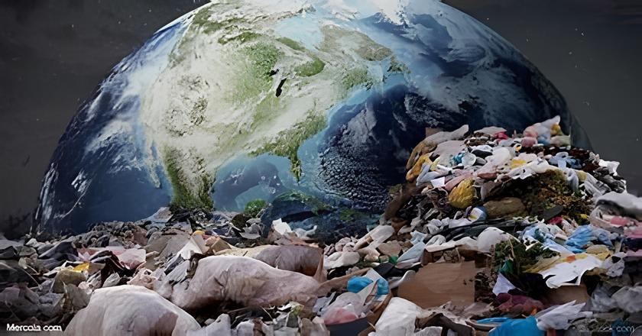
ENVIRONMENTAL IMPACT OF REPLACING PLASTICS with BAMBOO USING PYTHON PROGRAMMING
Faculty
Raveena Selvanarayanan
Presenter Name:
K. Yerriswamy
K. Phanindra
K. Gagan sai

Slide 2
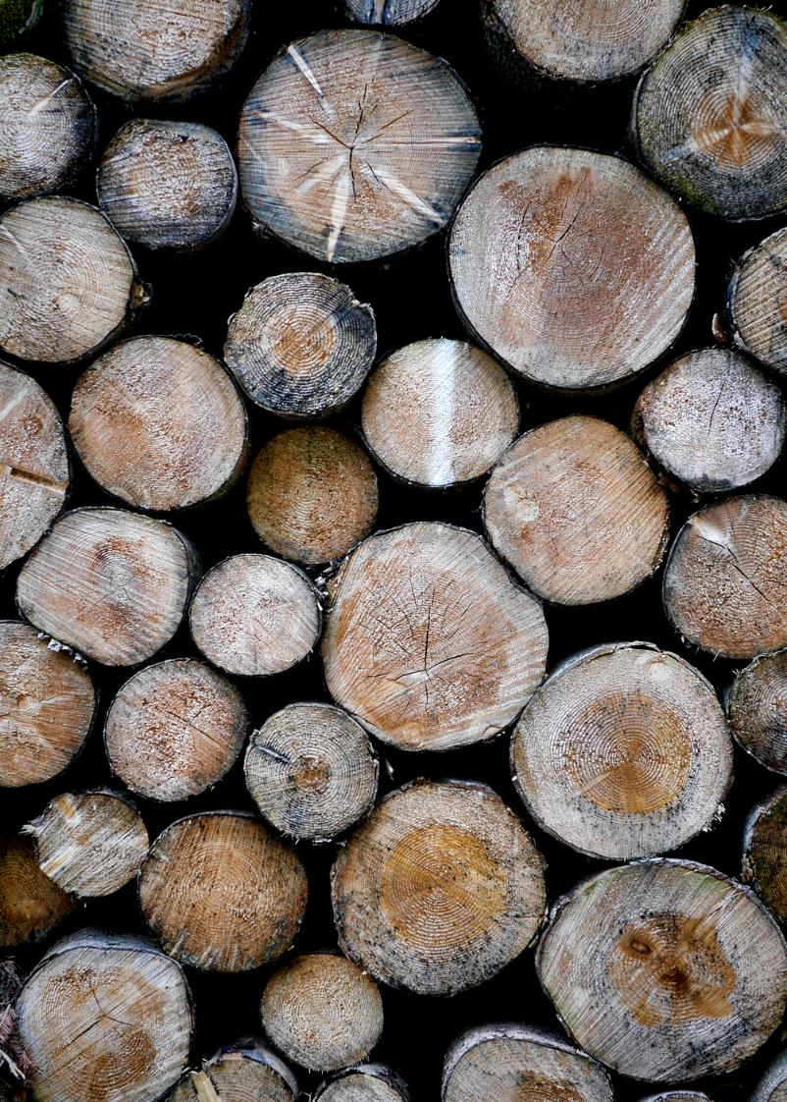
INTRODUCTION
Plastic usage is widespread in the packaging, aerospace, marine, and automobile industries because of their lightweight, low manufacturing costs.
The storage capacity of non-renewable resources such as oil, coal and natural gas.
Bamboo with its unique properties and environmental benefits, has emerged as a promising substitute.
Reduced plastic pollution, renewable resource usage, carbon sequestration, energy consumption, biodiversity conservation, and chemical pollution reduction.

Slide 3

The geographical distribution of bamboo in the world can be divided into three major bamboo regions
Asia-Pacific Bamboo Region
Americas Bamboo Region
Africa Bamboo Region
The main bamboo-producing countries include China, India, Thailand, Myanmar, Bangladesh, etc,.
The same area of bamboo forest can release 35% more oxygen than a forest.
The use of bamboo as a renewable resource to reduce plastic pollution .

Slide 4
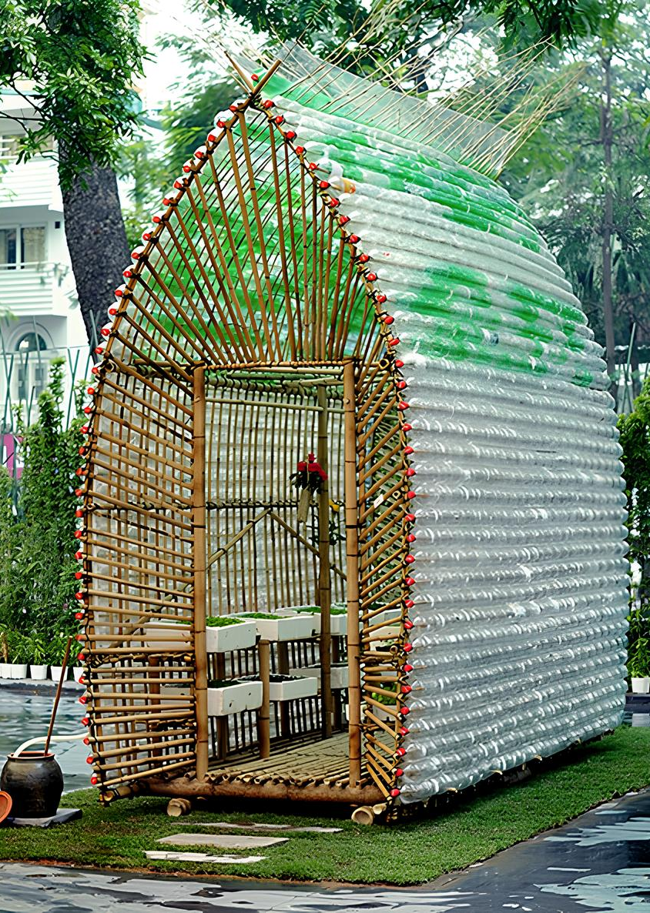
ABSTRACT:
Natural fibers, bamboo is characterized by fast growth, a short cultivation period, high strength and good toughness, and is one of the strongest natural fibers in the world
In addition to their environmental protection and green production
Mechanical properties of bamboo-fiber-reinforced thermoplastic composites
High-performance bamboo fiber to minimize plastic pollution
Structural features conferred excellent strength, water resistance, oil resistance, better high- and low-temperature resistance
That replacing 20% of plastic tableware products with the bamboo fiber
Equal to reducing carbon emissions equivalent to 300,000 cars in a small city.
Keywords: bamboo fiber, plastic, natural, mechanical.

Slide 5
PRIMARY OBJECTIVES:
Environmental Sustainability: Bamboo is biodegradable and renewable, making it a more environmentally friendly alternative to plastic.
Plastic Pollution Reduction: Substituting plastic with bamboo helps reduce the amount of plastic waste entering landfills and natural environments.
Resource Conservation: Bamboo requires fewer resources to grow and harvest compared to the production of plastic.
Carbon Footprint Reduction: Bamboo has a lower carbon footprint than plastic due to its ability to sequester carbon dioxide during growth.
Promotion of Sustainable Practices: Embracing bamboo as an alternative to plastic encourages the adoption of more sustainable manufacturing and consumption practices.
Diverse Applications: Bamboo can be used in various products and industries, including packaging, construction materials, textiles, utensils.

Slide 6
SECONDARY OBJECTIVES:
Renewability: Bamboo is a highly renewable resource as it grows rapidly, sometimes up to several feet in a single day, and can be harvested annually without causing damagee to the environment.
Biodegradability: Unlike plastic, which can take hundreds of years to decompose, bamboo is biodegradable
Low Environmental Impact: Bamboo cultivation typically requires minimal water, no pesticides, and no fertilizers, making it a more environmentally friendly option compared to the production of plastic.
Strength and Durability: Bamboo fibers are known for their strength and durability, making bamboo-based products a viable alternative to traditional plastic items.
Carbon Sequestration: Bamboo plants absorb large amounts of carbon dioxide from the atmosphere, helping to mitigate climate change by acting as a carbon sink.
Consumer Demand: There is a growing demand among consumers for sustainable and eco-friendly products, driving businesses to seek alternatives to plastic, with bamboo emerging as a popular choice.

Slide 7
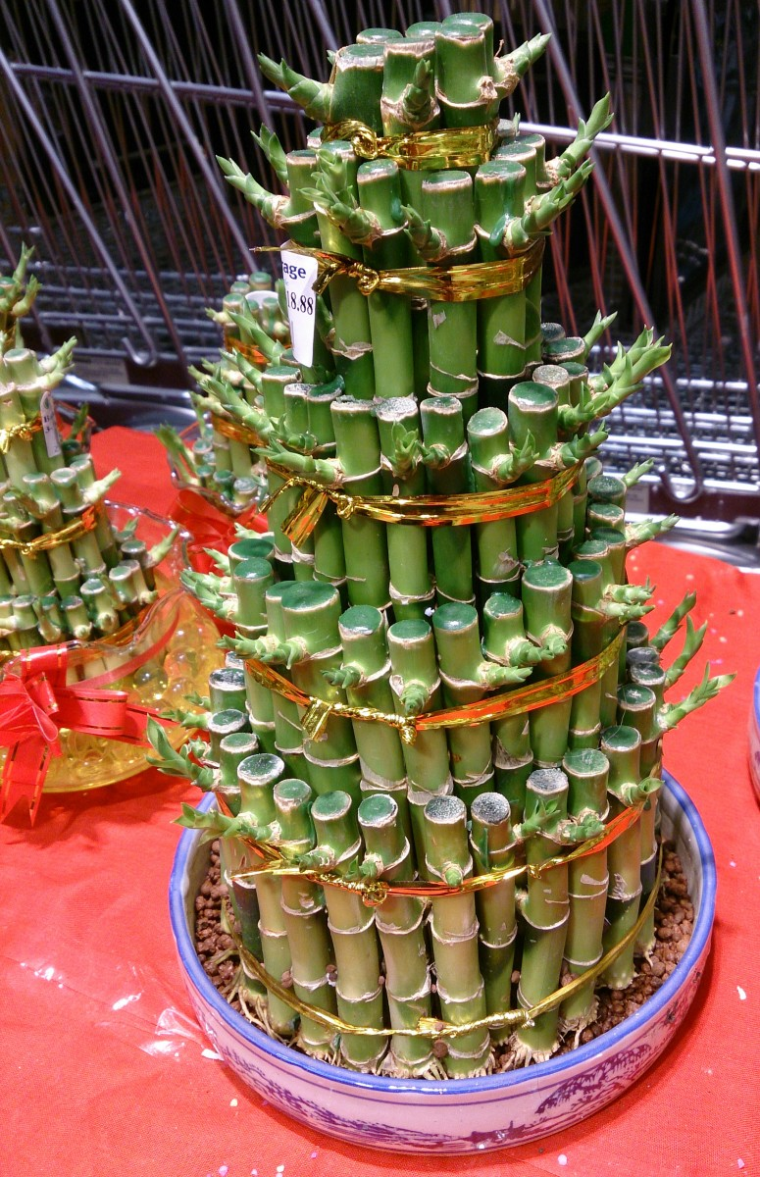
Advantages:
Plastic is light in weight.
Plastic is cheap to produce.
Plastic bottles can be restored and reused over again and again.
Fast growing
High productive
Light, Strong and Versatile.

Slide 8
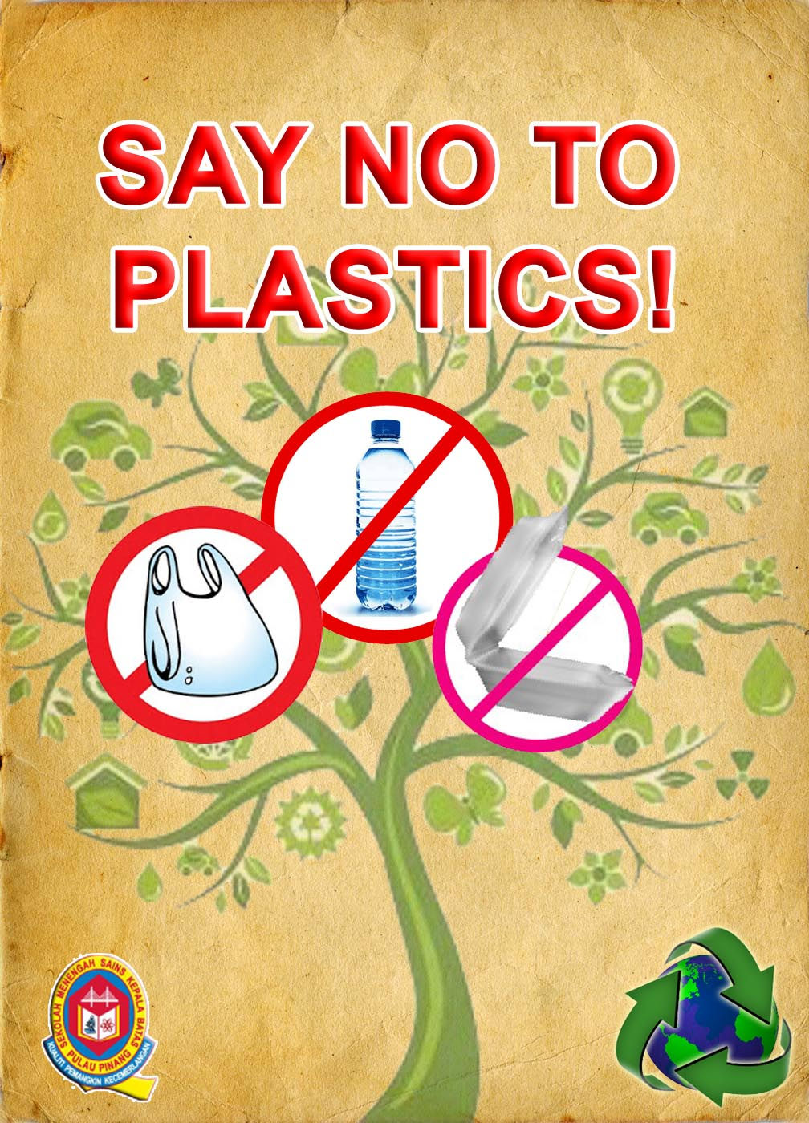
DISADVANTAGES:
The recycling process is very costly.
Plastic causes cancer.
Plastic show deformation under load.
Plastic is soft.
Bamboo shrinks much greater as compared to other types of materials
Bamboo may absorb water during the casting and curing of the concrete.
If the bamboo is not sufficiently treated it may undergo the fungus attack or attacks caused by insects.

Slide 9
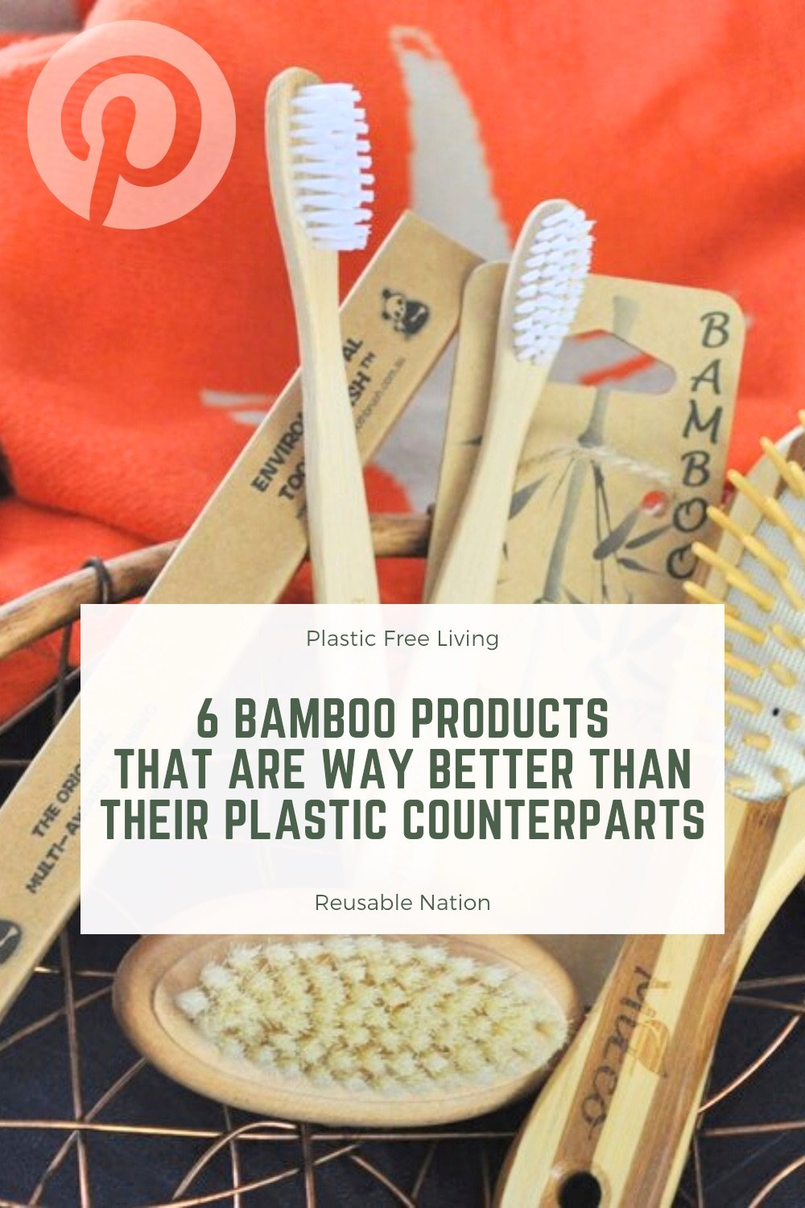
FUNCTIONAL REQUIREMENTS:
Transportation-Analyze carbon footprint of transportation.
Product End-of-Life-Assess disposal methods and environmental impact.
Social and Economic Impacts-Evaluate social and economic implications.
Regulatory Compliance-Ensure compliance with environmental regulations.
Stakeholder Engagement-Engage with stakeholders for input and concerns.

Slide 10
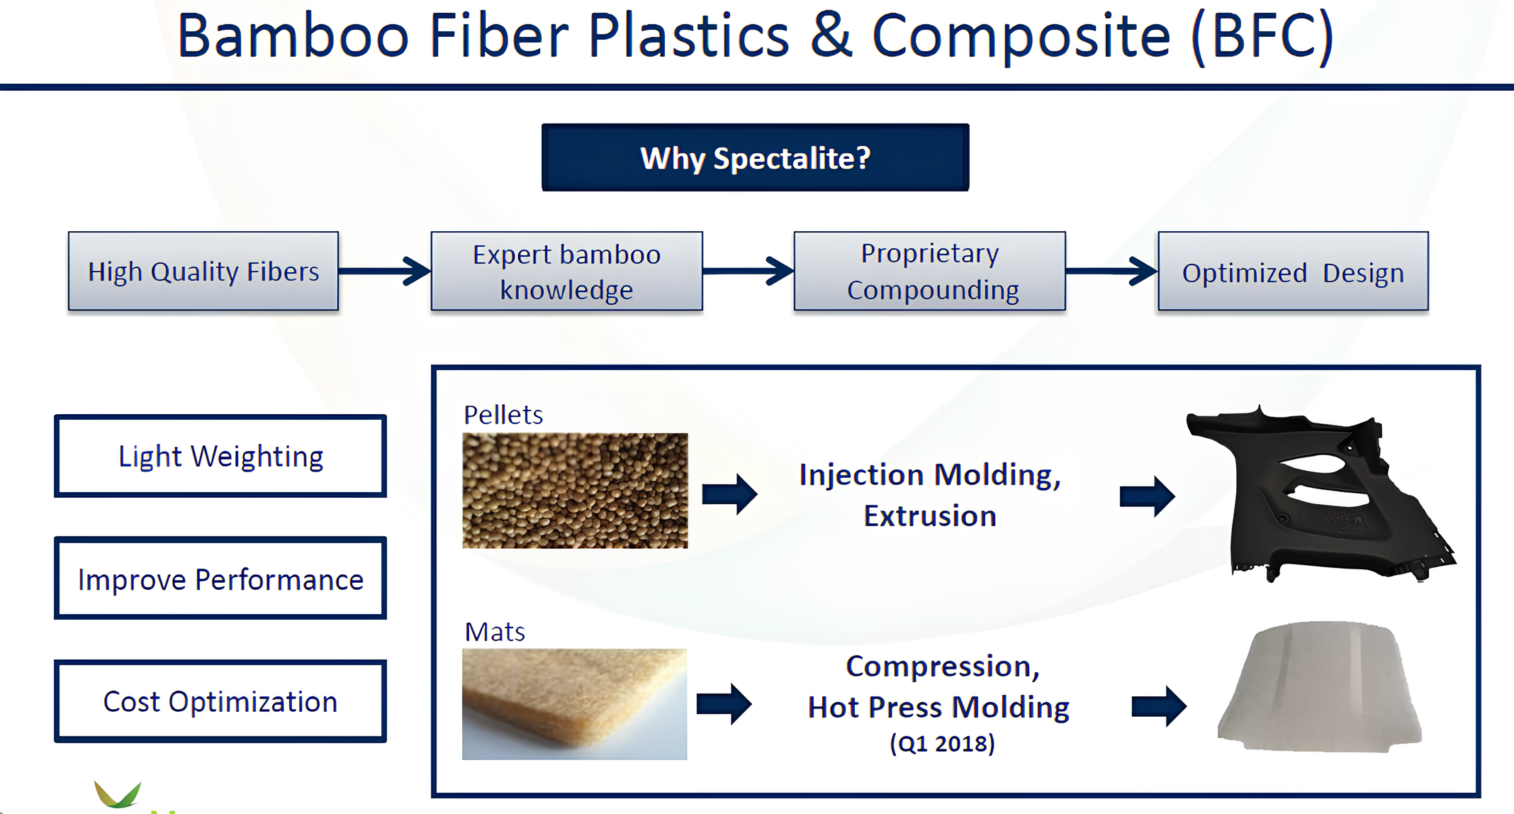
ARCHITECTURE DIAGRAM:

Slide 11
How related to computer science students
Computer science students learn how using Python can help understand and address environmental issues by analyzing data on plastic pollution and promoting bamboo as a sustainable alternative, supporting advocacy for eco-friendly policies.
Firstly, students need to grasp the gravity of the plastic pollution problem, understanding its detrimental effects on ecosystems and human health.
Through Python, students study the environmental impact of plastics, explore bamboo as a sustainable substitute, and advocate for eco-friendly policies.

Slide 12
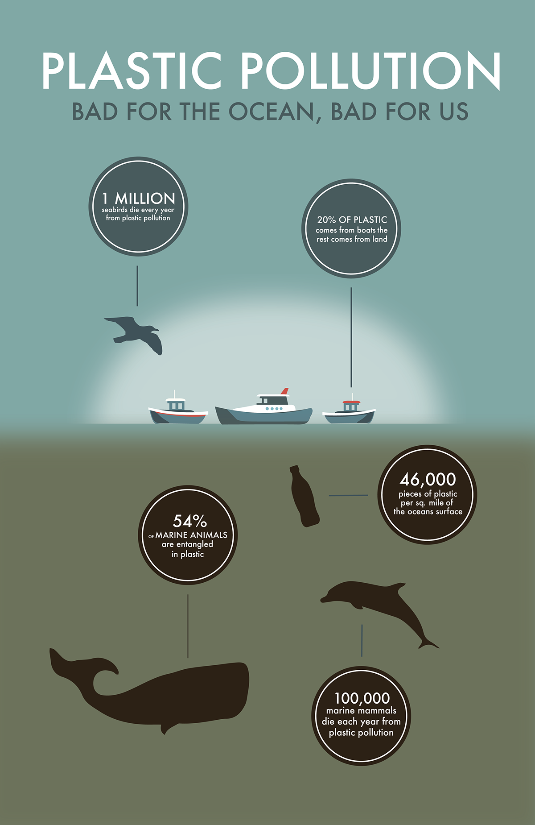
CODING:
carbon_footprint_plastics = 10
carbon_footprint_bamboo =2
plastics_production = 1000
bamboo_production = 1000
total_carbon_plastics = carbon_footprint_plastics * plastics_production
total_carbon_bamboo = carbon_footprint_bamboo * bamboo_production
print("Total carbon footprint for producing plastics:", total_carbon_plastics, "kg CO2 equivalents")
print("Total carbon footprint for producing bamboo-based products:", total_carbon_bamboo, "kg CO2 equivalents")
carbon_footprint_reduction = total_carbon_plastics - total_carbon_bamboo
print("By replacing plastics with bamboo, you would reduce carbon footprint by:", carbon_footprint_reduction, "kg CO2 equivalents")
OUTPUT:
Total carbon footprint for producing plastics: 10000 kg CO2 equivalents
Total carbon footprint for producing bamboo-based products: 2000 kg CO2 equivalents
By replacing plastics with bamboo, you would reduce carbon footprint by: 8000 kg CO2 equivalents

Slide 13
CONCLUSION:
Replacing plastics with bamboo can have several positive environmental impacts.
Bamboo is a renewable resource that grows quickly and requires fewer resources to cultivate compared to many plants used for plastic production.
By utilizing bamboo-based products, we can reduce plastic pollution, decrease our reliance on fossil fuels, and mitigate the carbon footprint associated with traditional plastic manufacturing processes.
Natural bamboo fiber has many advantages such as a large aspect ratio, high specific strength, large surface area, low density, and being inexpensive, renewable and biodegradable
Environmental protection and density.
Achieve “replacing plastics with bamboo” to promote the green development of the economy.

Slide 14
REFERENCES:
Chen, Y.; Awasthi, A.K.; Wei, F.; Tan, Q.Y.; Li, J.H. Single-use plastics: Production, usage, disposal, and adverse impacts. Sci. Total Environ. 2021, 752, 141772. [Google Scholar] [CrossRef] [PubMed].
Williams, A.T.; Rangel-Buitrago, N. The past, present, and future of plastic pollution. Mar. Pollut. Bull. 2022, 176, 113429. [Google Scholar] [CrossRef] [PubMed].
Opeyemi, B.M. Path to sustainable energy consumption: The possibility of substituting renewable energy for non-renewable energy. Energy 2021, 228, 120519. [Google Scholar] [CrossRef].
.Xian, G.; Guo, R.; Li, C. Combined effects of sustained bending loading, water immersion and fiber hybrid mode on the mechanical properties of carbon/glass fiber reinforced polymer composite. Compos. Struct. 2022, 281, 115060. [Google Scholar] [CrossRef.]
Stalin, A.; Mothilal, S.; Vignesh, V.; Sanjay, M.R.; Siengchin, S. Mechanical properties of hybrid vetiver/banana fiber mat reinforced vinyl ester composites. J. Ind. Text. 2022, 51, 5869S–5886S. [Google Scholar] [CrossRef]

Slide 15


